Slide 1
8th Grade Trip Options
3, 2, 1…

Slide 2
Option 1: Ohio

Slide 3
Things to Do
Cedar Point!

Slide 4
Drive Time:
About 5 hours

Slide 5
Schedule
Time | Activity
7:00 AM | Arrive at CLC
7:15 AM – 12 PM | Drive to Cedar Point
8 AM | Breakfast
12 PM – 6 PM | Cedar Point
12 PM | Lunch at Cedar Point
5 PM | Dinner at Cedar Point
6 PM – 11 PM | Drive to CLC

Slide 6
Budget
Event | Unit Cost | Quantity | Total Cost
Bus | $2000.00 | 1 | $2,000.00
Cedar Point | $50.00 | 20 | $1,000.00
Lunch | $20.00 | 20 | $400.00
Dinner | $20.00 | 20 | $400.00
 |  |  | $3,800.00

Slide 7
Option 2: NYC

Slide 8
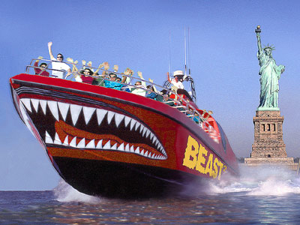
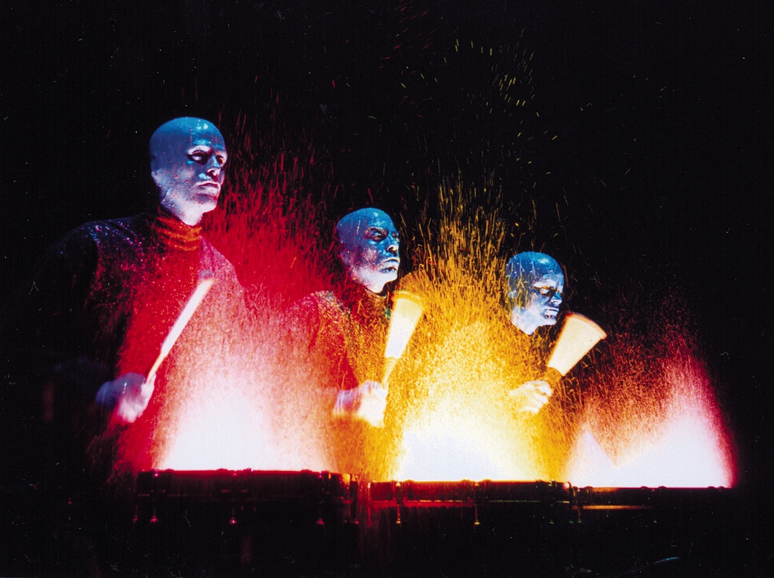
Things to Do
Medieval Times, NYC, Blue Man Group

Slide 9
Drive Time:
About 4.5 hours

Slide 10
Schedule
Time | Activity
7:00 AM | Arrive at CLC
7:15 AM – 11 AM | Drive to Medieval Times
11 AM – 1 PM | Medieval Times
1 PM – 2 PM | Drive to The Beast
2 PM – 3 PM | The Beast
3:30 PM – 5:30 PM | Blue Man Group
6 PM – 10 PM | Drive to CLC
7 PM | Grab Dinner on the Road

Slide 11
Budget
Event | Unit Cost | Quantity | Total Cost
Bus | $2,000.00 | 1 | $2,000.00
Medieval Times | $40.00 | 20 | $800.00
The Beast | $30.00 | 20 | $600.00
Blue Man Group | $75.00 | 20 | $1,500.00
Dinner | $15.00 | 20 | $300.00
 |  |  | $5,200.00

Slide 12
What do you think?

